Slide 1
Weekly Update #28
Gijs Admiraal

Slide 2
This week?
Finished the whole evaluation pipeline
Completed the SELFIES metrics
Results pipeline on 4 models
Completed writing introduction
Finishing writing background
Tried to debug training

Slide 3
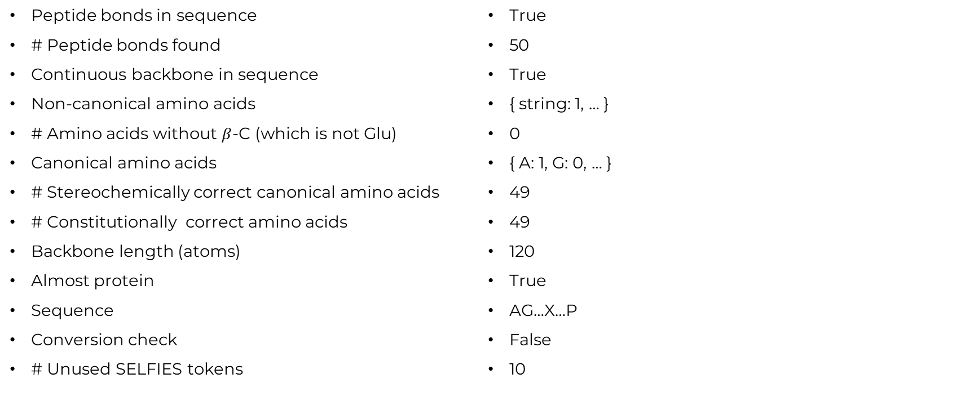
SELFIES metrics
Peptide bonds in sequence
# Peptide bonds found
Continuous backbone in sequence
Non-canonical amino acids
# Amino acids without $β$-C (which is not Glu)
Canonical amino acids
# Stereochemically correct canonical amino acids
# Constitutionally correct amino acids
Backbone length (atoms)
Almost protein
Sequence
Conversion check
# Unused SELFIES tokens
True
50
True
{ string: 1, … }
0
{ A: 1, G: 0, … }
49
49
120
True
AG…X…P
False
10
+ Token Distribution

Slide 4
Amino acid metrics
Token distribution
Blast uniqueness:
#matches,
e-values,
query coverage
alignment score
identity
Blast diversity
OmegaFold plDDT:
Average plDDT

Slide 5
Amino acid model results
Uniform & Absorbing

Slide 6
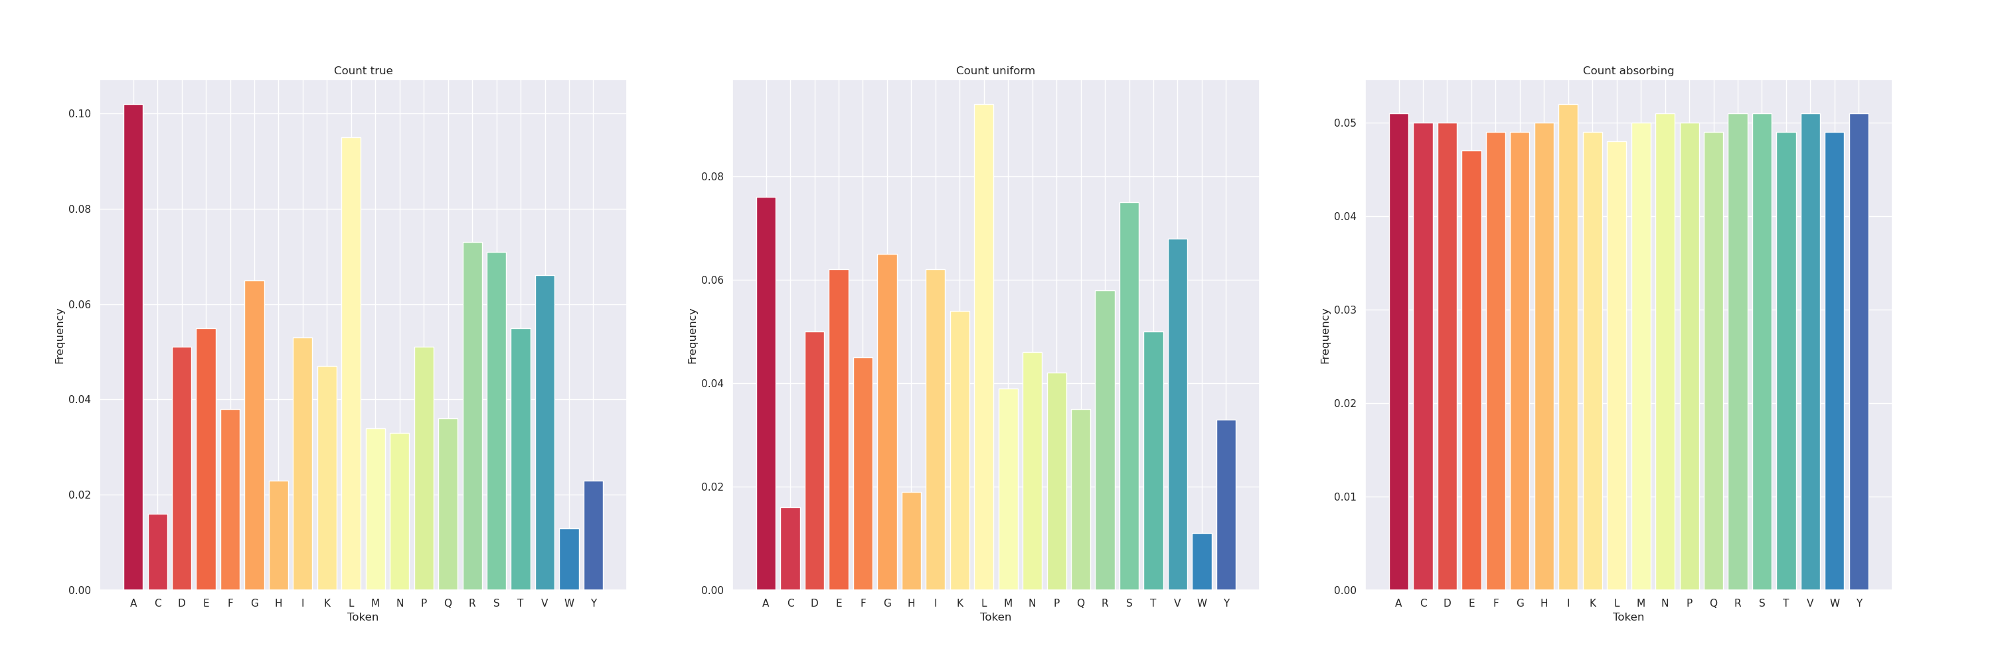
Results amino (500 seq)

Slide 7
Results amino uniform (500 seq)
Length 50: MTTLNNSKKKKDVELDASSSTVADKTGVILINCNTFYTMTLYSHSSIMSA
Length 60: MENYSNRILKNMLSNRKMLNNLLDLKKRTICLLILDITQNDESTDGGDLALLFFPTSSEK
Length 70: MTGSNTYHQSRYGLGIAFLCGVGGCGSCIWAELSRAALNPRSEEATFDAQTHACVLGLSVWGLVCGLALT
Length 80: MVAKDNILQQELMRVWCEQYFKGRSKPAYSFANRPLFHTMVAFDGIEKLKPSRNGLVMEDGELFAICKRHPNSASSPSIQ

Slide 8
Results amino absorbing (500 seq)
Length 50: KLWENHLGSAVSMNTFIMMNGCILVTYVKTFLYPYLEWEHGLHTEQQAFH
Length 60: NGMDLMMMMDGYQINRAPWTQIQYGPDNISGAADIAYHDYKHSYRKWSHVYWMGEWRFDM
Length 70: NPEPTCYGNWYNIQAVVMDESWTVDYLIIELNFIQATIYYPYQFVPKTPHKACNILCWENSWCQQVVHAA
Length 80: SVHITPIMEENTVFYEDRAPGKEGPCAYTVMSDLAMCHIPFSCPMLPVHTWPDKAHHRAPNAPFPSFAICWCTFDGYNKR

Slide 9
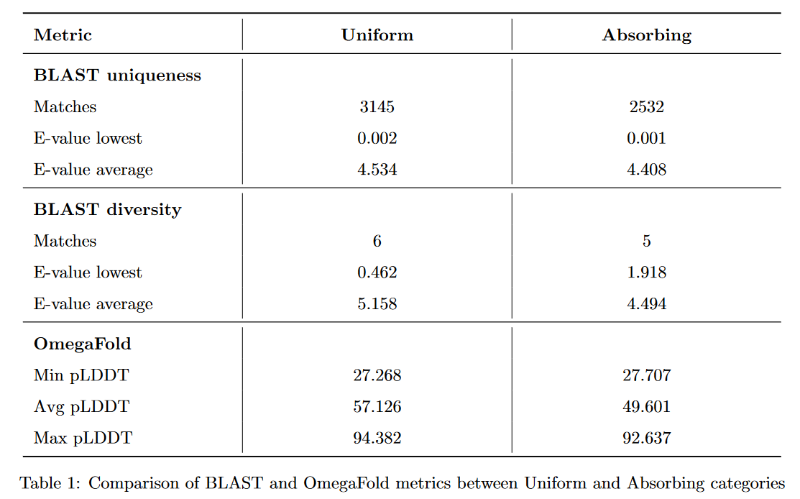
Results amino (500 seq)

Slide 10
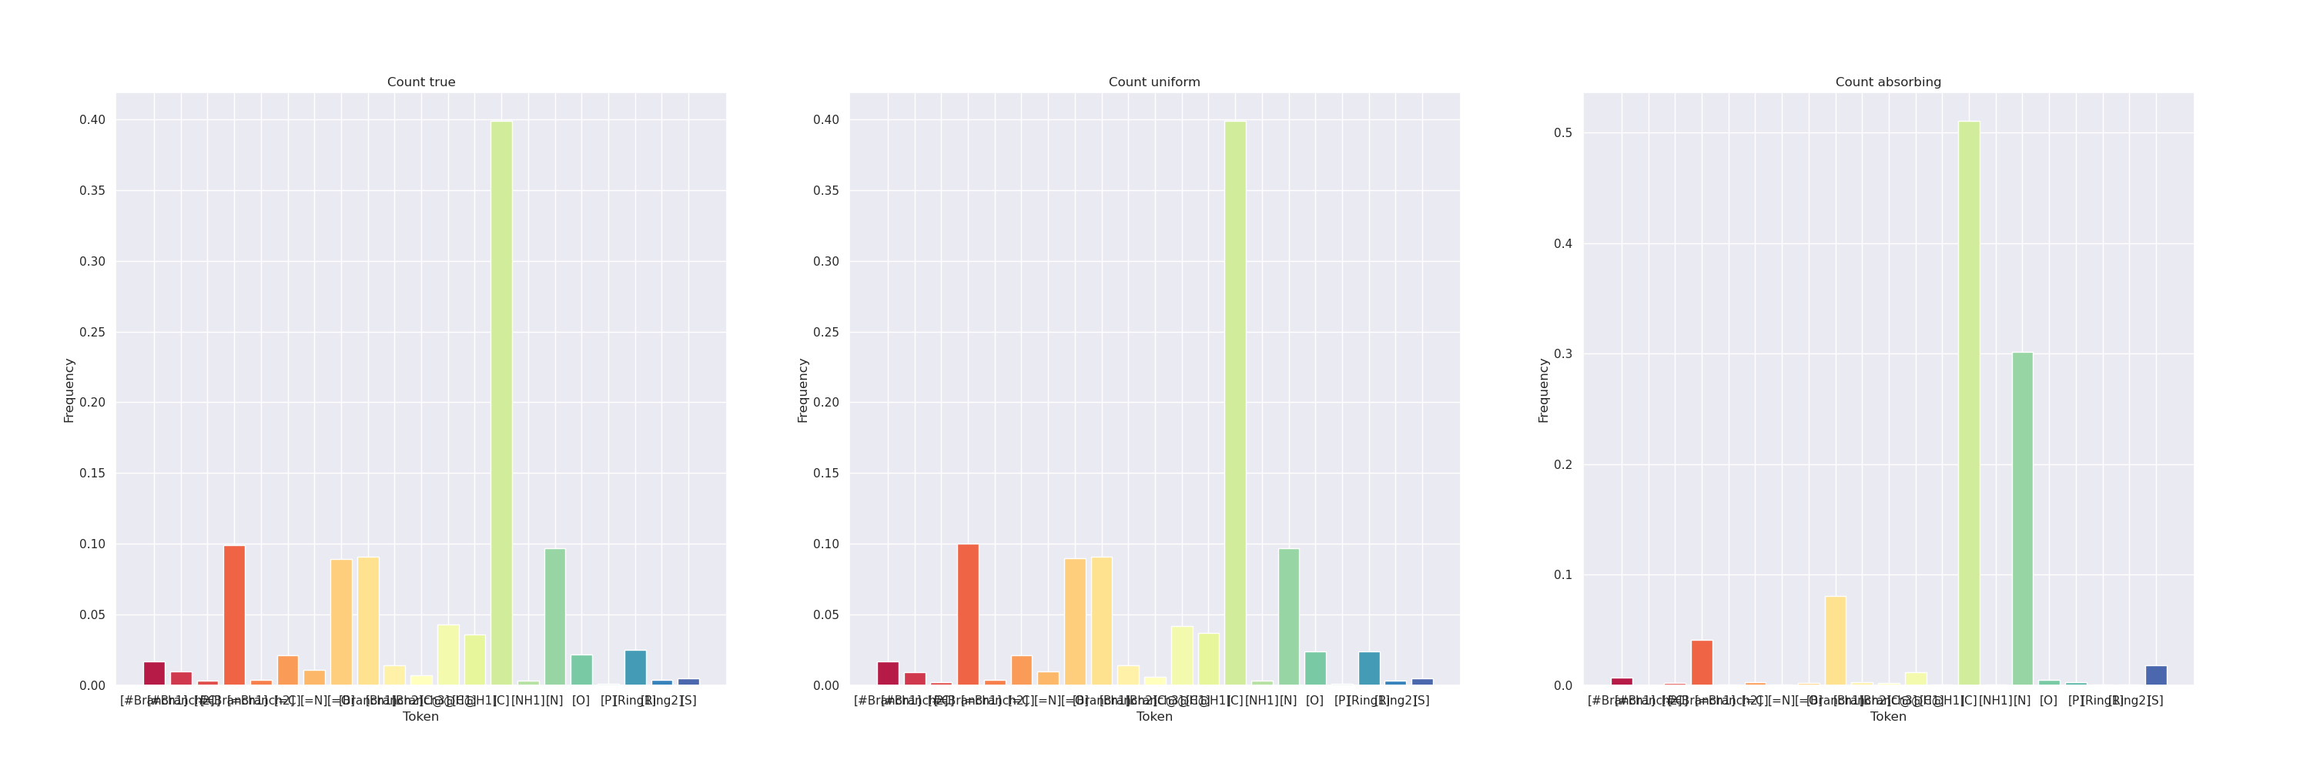
Results Selfies (500 seq)

Slide 11
Example SELFIES uniform
Length 406 [C][C][C@H1][Branch1][C][C][C@H1][Branch2][Ring2][=N][N][C][=Branch1][C][=O][C@H1][Branch1][=Branch1][C][C][C][C][N][N][C][=Branch1][C][=O][C@H1][Branch1][#Branch2][C][C][C][N][C][=Branch1][C][=N][N][N][C][=Branch1][C][=O][C@@H1][Branch1][C][N][C][Branch1][C][C][C][C][=Branch1][C][=O][N][C@@H1][Branch1][=N][C][C][=C][C][=C][Branch1][C][O][C][=C][Ring1][#Branch1][C][=Branch1][C][=O][N][C@@H1][Branch1][Branch1][C][C][S][C][C][=Branch1][C][=O][N][C@H1][Branch3][Ring1][Branch1][C][C][=Branch1][C][=O][N][C@@H1][Branch1][#Branch1][C][C][=Branch1][C][=O][O][C][=Branch1][C][=O][N][C@@H1][Branch1][#Branch1][C][C][=Branch1][C][=O][O][C][=Branch1][C][=O][N][C@@H1][Branch1][=Branch1][C][C][C][C][N][C][=Branch1][C][=O][N][C@H1][Branch2][P][O][C][=Branch1][C][=O][N][C@@H1][Branch1][C][C][C][=Branch1][C][=O][N][C@@H1][Branch1][Branch2][C][C][C][=Branch1][C][=O][O][C][=Branch1][C][=O][N][C@@H1][Branch1][#Branch1][C][C][Branch1][C][N][=O][C][=Branch1][C][=O][N][C@@H1][Branch1][#Branch1][C][C][Branch1][C][N][=O][C][=Branch1][C][=O][N][C@@H1][Branch1][#Branch1][C][C][Branch1][C][C][C][C][=Branch1][C][=O][N][C@@H1][Branch1][Ring1][C][O][C][=Branch1][C][=O][N][C@@H1][Branch1][#Branch1][C][C][=Branch1][C][=O][O][C][=Branch1][C][=O][N][C@@H1][Branch1][Branch2][C][C][C][=Branch1][C][=O][O][C][=Branch1][C][=O][N][C@@H1][Branch1][#Branch1][C][C][Branch1][C][C][C][C][=Branch1][C][=O][N][C@@H1][Branch1][#Branch2][C][C][=C][C][=C][C][=C][Ring1][=Branch1][C][=Branch1][C][=O][N][C@@H1][Branch1][#Branch2][C][C][C][N][C][=Branch1][C][=N][N][C][=Branch1][C][=O][N][C@@H1][Branch1][Ring1][C][O][C][=Branch1][C][=O][N][C@H1][Branch2][=Branch1][#Branch2][C][=Branch1][C][=O][N][C@@H1][Branch1][#Branch2][C][C][=C][C][=C][C][=C][Ring1][=Branch1][C][=Branch1][C][=O][N][C@@H1][Branch1][=Branch1][C][C][C][C][N][C][=Branch1][C][=O][N][C@@H1][Branch1][C][C][C][=Branch1][C][=O][N][C@@H1][Branch1][#Branch1][C][C][Branch1][C][C][C][C][=Branch1][C][=O][N][C@@H1][Branch1][Branch2][C][C][C][Branch1][C][N][=O][C][=Branch1][C][=O][O][C][Branch1][C][C][C][C@@H1][Branch1][C][C][O][C][Branch1][C][C][C]
VRKIYMVDDKTAENNLSDELFRSVFKALQ

Slide 12
All true proteins SELFIES uniform
>85
MMCGSTAQDETALTGMLCAMCSDYGICDRLHLSLGCARMGLR
>88
MGPGQRRAAAAGFIPAPQGIRTEAASGELRTKHRA
>334
MDLDLLRPRKGLTISLVVPSMDAIKQELSAATDGIITAKAMACR
>343
VRKIYMVDDKTAENNLSDELFRSVFKALQ
>391
MEELNLKELSGAGIFLWMQQTAIHATFPRYLDLSTTNGARSLAKSVPFFRV
>480
MGSNIVMTRSAIKTEPDLVDRPGYTISDTKKMKGA

Slide 13
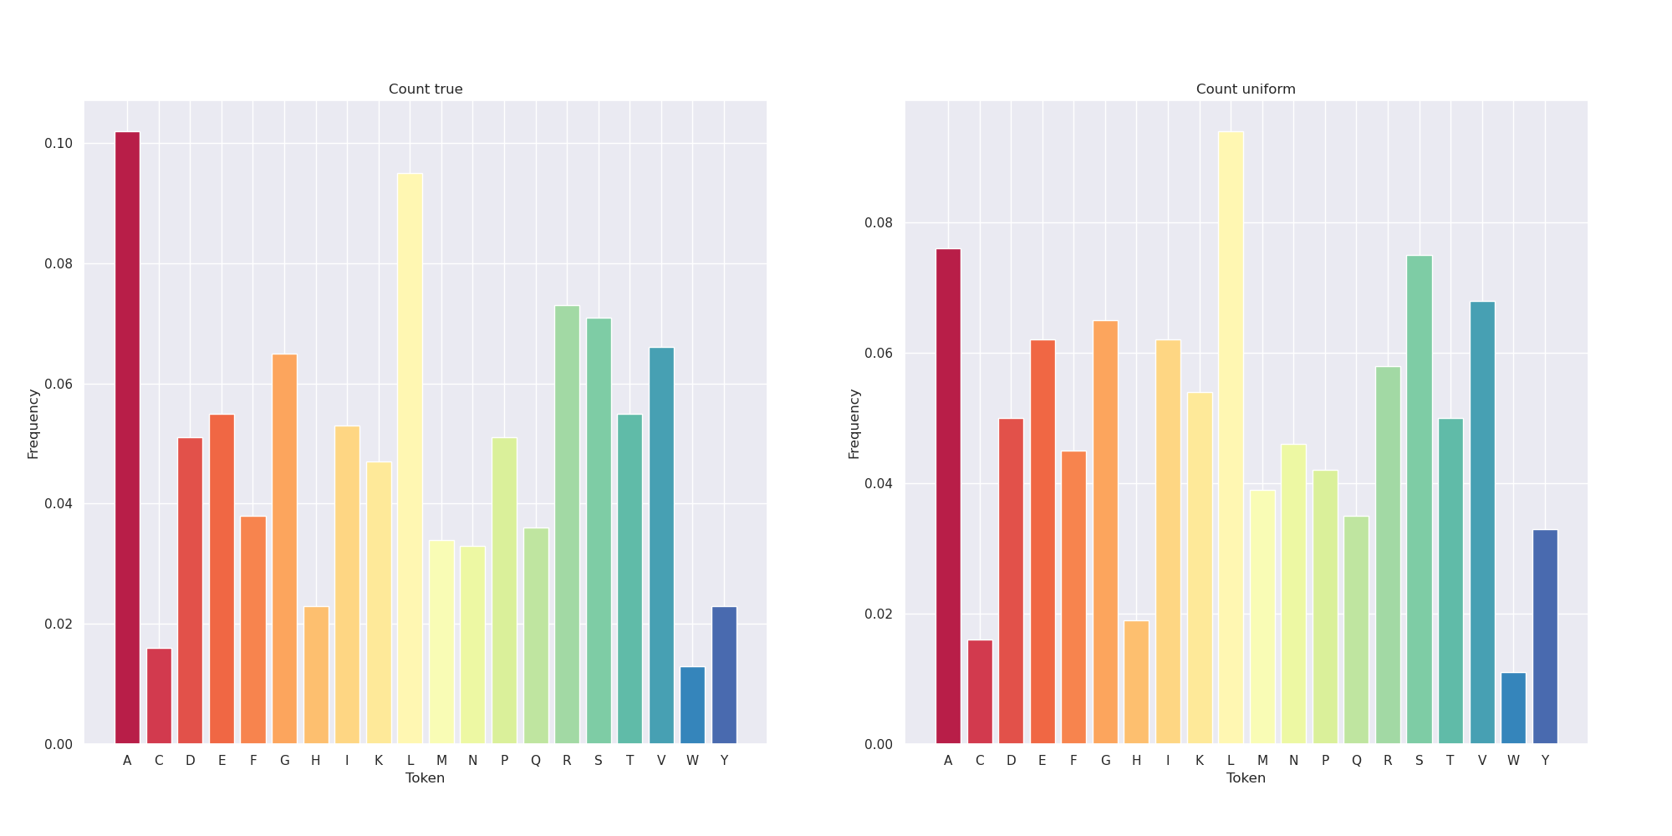
Token distribution selfies to amino acid

Slide 14
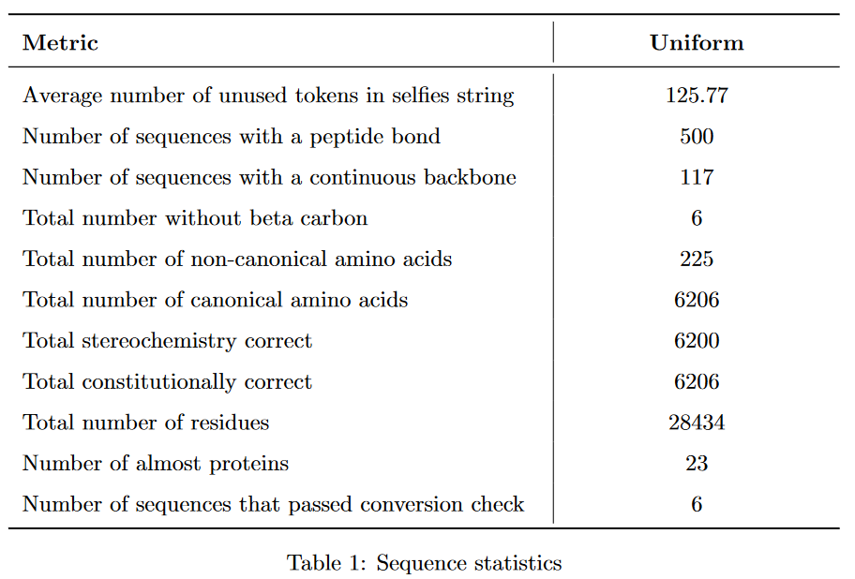
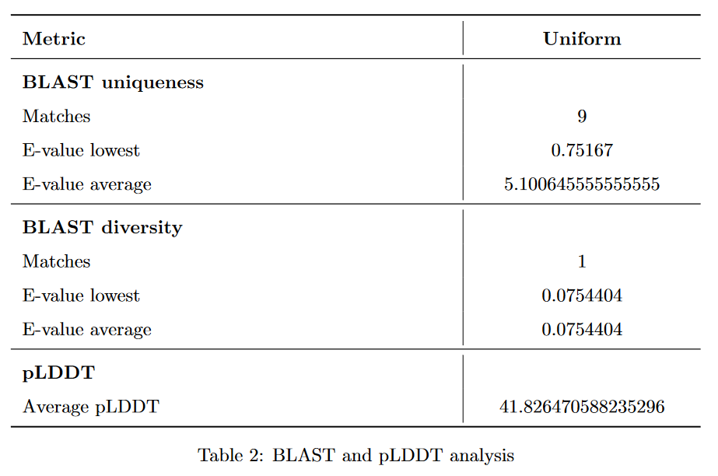
Results uniform selfies

